Slide 1

Image failed to load:
file:///tmp/html2pptx_svg/svg_9f8d4f6c-329e-47b8-b...
AI INNOVATIONS
AI-Powered Solutions Portfolio
Enterprise Financial Platform & Healthcare Solutions
Board-Level Technical Report | 2026

Slide 2

01
Executive Summary
06
Conversational AI Platform
Key highlights and strategic overview
Multi-modal voice/chat solutions
02
AI Solutions Map
07
Banking Document OCR
Portfolio visualization & verticals
Automated form processing
03
Healthcare AI Solutions
08
Fintech Digital Wallet
Medical assistant & digital doctor
Payments & financial platform
CONTENTS
04
DiagnosticCentre AI
09
Technical Architecture
Overview
Digital transformation portal
Layered system design
05
AR/VR Medical Learning
10
Performance Metrics
Immersive education platform
Business impact & KPIs
11
Delivery Status
12
Comparative Insights
Solution maturity overview
Cross-project synergies
13
Platform Maturity
14
Pharmacist Chatbot
Current status & roadmap
Medicine intelligence platform
15
Conclusion
AI INNOVATIONS
Strategic value & next steps

Slide 3
85%
40%
EXECUTIVE SUMMARY
Screening Time Reduction
Early Cancer Detection Increase
Portfolio Overview
70%
70-80%
Updated AI-powered solutions portfolio featuring 7 major platforms across healthcare, banking, retail, and education sectors with quantifiable business impact and proven delivery success.
Call Volume Deflection
Bank Form Processing Speed
Portfolio Status: Live & Delivered • MVP Complete • Demo Available
AI INNOVATIONS

Slide 4





AI SOLUTIONS MAP
Portfolio Overview
AI INNOVATIONS
Healthcare
Banking & Finance
Medical AI Assistant & Digital Doctor
OCR Platform & Digital Wallet
AI Solutions Portfolio
Retail & E-commerce
Education & Training
Conversational AI & Analytics
AR/VR Medical Learning Suite

Slide 5

HEALTHCARE AI
Medical AI Assistant & Digital Doctor
Medical Image Reader
CNN + GPT-4V for CT/MRI/X-ray analysis with risk stratification
Prescription OCR
Vision transformer for Bangla+English handwriting recognition
Symptom Analysis
Medical triage, differential diagnosis & pre-screening support
Digital Doctor
24/7 GP-level triage with doctor-in-loop validation
35%
95.6%
40%
Radiologist Workload Reduction
OCR Accuracy
Early Detection Improvement
AI INNOVATIONS

Slide 6
HEALTHCARE AI
Real-World Impact
Pain Points Solved
85%
40%
35%
Key Challenges
Screening Time Reduction
Early Cancer Detection ↑
Radiologist Workload ↓
Diagnostic Bottlenecks: Radiologist workload ↑30-50%, 3-5% errors, 4-6 week delays in rural areas
Prescription Errors: Illegible handwriting causing medication mistakes & adverse drug interactions
95.6%
24hrs
24/7
OCR Accuracy (Bangla+English)
Same-Day Risk Assessment
Digital Doctor Support
Triage Inefficiency: 40% of GP time on non-expert intervention cases
Limited Access: No 24/7 medical guidance, patients travel or wait for appointments
AI INNOVATIONS

Slide 7
DIGITAL TRANSFORMATION
DiagnosticCentre AI
Key Impact Metrics
Online Appointment Booking
Real-time slot availability, WhatsApp/SMS confirmations, bookings under 3 minutes
Staff Workload Reduction
60
%
Report Management
Portal Adoption Rate
>50
QR-code enabled upload/download, LIS integration, paperless handling
%
AI Chatbot (MedBot)
<3
Symptom checker, FAQ handling, intelligent triage, escalation to staff
Booking Time Reduction
min
Admin Panel with HITL
Doctor scheduling, patient oversight, AI output approval workflow
AI INNOVATIONS

Slide 8
DIAGNOSTIC CENTRE AI
Real-World Impact
Pain Points Solved
60%
<3 min
Key Challenges
Staff Workload Reduction
Appointment Booking Time
Manual Appointment Booking No 24/7 self-service, phone-based only, long wait times
Paper-Based Reports No digital access, patients cannot retrieve records online
>50%
High
No ERP Integration System duplication, manual data entry, inefficiency
Portal Adoption Rate
Patient Satisfaction
Absence of AI Triage Patients lack initial guidance, no pre-visit support
Key Outcomes: Paperless report handling, enhanced patient engagement with real-time notifications, streamlined operations with AI-powered chatbot support
AI INNOVATIONS

Slide 9
Customer Care & Platform Guides
CONVERSATIONAL AI
Multi-Modal Platform
E-Commerce Assistant
Virtual Tour Guide
Product search, personalized recommendations, order tracking, smart negotiations
Interactive museum/experience navigation, contextual information, multi-language support
Voice Biometrics
99.1% accuracy, 3s authentication, secure user verification
Multi-Language Support
Bangla, English, Banglish + 40+ language translation
Sentiment Analysis
LMS Platform Guide
Banking Assistant
Predicts escalation 90s early with 72% accuracy
Course recommendations, learning path optimization, instructor Q&A, progress tracking
Balance inquiries, fund transfers, fraud alerts, financial advice 24/7
Negotiation Engine
Reinforcement learning for discounts and upgrades
Whisper Agent
Real-time knowledge surfacing & automated summarization
Virtual Doctor (GP)
Instructor Support
Symptom triage, health advice, appointment scheduling, prescription guidance
Automated grading, student performance analysis, content recommendations
AI INNOVATIONS

Slide 10
CONVERSATIONAL AI
Pain Points Solved
22%
+12%
60%
Conversion Lift Voice Commerce
Average Order Value Increase
Call Volume Reduction
Call-Center Cost Escalation
$1.30-1.80/minute, 15% YoY handle time increase
Language Barriers
ANNUAL SAVINGS
72% prefer native language, 40% international leads lost
~$12M
High Cart Abandonment
70% due to lack of real-time assistance
Low-Value Inquiries
60% of banking calls are simple account questions
AI INNOVATIONS

Slide 11
DOCUMENT PROCESSING
Banking OCR/ICR Platform
Account-Opening & KYC
Cheque Processing
Auto-pass & maker-checker workflow with confidence scoring
Handwriting recognition & fraud detection with AI analysis
95%+
85%+
English Accuracy
Bangla Accuracy
Technical Architecture
Vision Transformer
Confidence-Based HITL
Immutable Audit Log
Tesseract Fallback
Key Benefits
Loan Applications
Regulatory Reporting
95%+ English Accuracy 85%+ Bangla Accuracy 70-80% Faster Processing
Multi-page PDF splitting & structured data extraction
Immutable audit log & compliance dashboards
70-80%
100%
Faster Processing
Audit Ready
AI INNOVATIONS

Slide 12
BANKING OCR
Pain Points Solved
95%+
85%+
English Accuracy
Bangla Accuracy
Time-Consuming Entry: 15-20 minutes per document, 2-5% error rates
70-80%
<3 min
Poor Scan Quality: Mixed Bangla-English text, handwriting, strikethroughs
Faster Processing
Review Time Per Form
Compliance Gaps: No automated audit trail or maker-checker workflow
Key Outcomes: Accelerated clearing, fewer disputes, improved fraud detection, satisfies central-bank requirements, supports digital lending
Limited Scalability: Paper-centric processes cannot scale with digital banking growth
AI INNOVATIONS

Slide 13
FINANCIAL PLATFORM
Blockchain Enablement
Digital Wallet & Payments
Blockchain-Backed Wallet
Tokenized balance representation & on-chain recording
Identity & Access
Wallet Management
Stablecoin-Based Payments
Remittance, cross-border settlement, merchant payments
Payments & Transactions
Ledger & Accounting
KYC/KYB Onboarding
Compliance & Sanctions
Smart Contract Automation
Programmable treasury workflows & payment automation
Support & Admin
Blockchain & dApps
Hybrid Fiat-Crypto Wallet
Seamless fiat-to-crypto and crypto-to-fiat transactions
Core Capabilities
MFS Platform
Digital Banking
Payment Gateway
Merchant Payouts
Compliance Fintech
Blockchain Identity Verification
Decentralized credentials & external network integrations
AI INNOVATIONS

Slide 14


FINTECH WALLET
Pain Points Solved
Automated Onboarding
Built-in Compliance
Reduced verification time, regulatory compliance
KYC/KYB workflows, sanctions screening
Fragmented Services: Separate systems for onboarding, payments, accounting
Complex Compliance: Manual KYC/KYB checks slow onboarding, increase errors
Rapid Productisation
Transparent Ledger
Limited Interoperability: Wallets locked into specific providers
MFS, digital banking, payment gateway ready
Double-entry accounting, auditability
Ledger Integrity: No double-entry accounting, difficult reconciliation
Future-Proofing
Hybrid Web2-Web3 Wallet • Blockchain Enablement
Crypto Adoption: Existing wallets lack blockchain integration
AI INNOVATIONS

Slide 15
TECHNICAL ARCHITECTURE
Layered System Design
01
Client Access Layer
02
API & Application Layer
Mobile Apps
Web Apps
Admin Portal
Partner APIs
Authentication
Wallet Service
Payments
KYC/KYB
Compliance
Ledger
03
Integration Layer
04
Data & Infrastructure
Payment Providers
SMS Gateway
Email Service
PostgreSQL
Redis Cache
Document Storage
File Storage
Audit Logs
AI INNOVATIONS

Slide 16
PERFORMANCE METRICS
Pain Points Solved
Business Impact
Measurable outcomes demonstrating AI-driven efficiency, cost reduction, and quality improvements across healthcare and banking domains.
Healthcare
Banking
Healthcare
Diagnostic Bottlenecks & Wait Times
High Call Volume & Costs
Prescription Errors & Safety Risks
85%
85%
60%
95.6%
Screening Time Reduction
Faster Screening
Call Reduction
OCR Accuracy
40%
Early Cancer Detection Increase
35%
Banking
Healthcare
E-commerce
Radiologist Workload Reduction
Document Processing Delays
Radiologist Workload Overload
Low Conversion Rates
22%
70-80%
35%
Conversion Lift
95.6%
Faster Processing
Workload Reduction
OCR Accuracy
AI INNOVATIONS

Slide 17
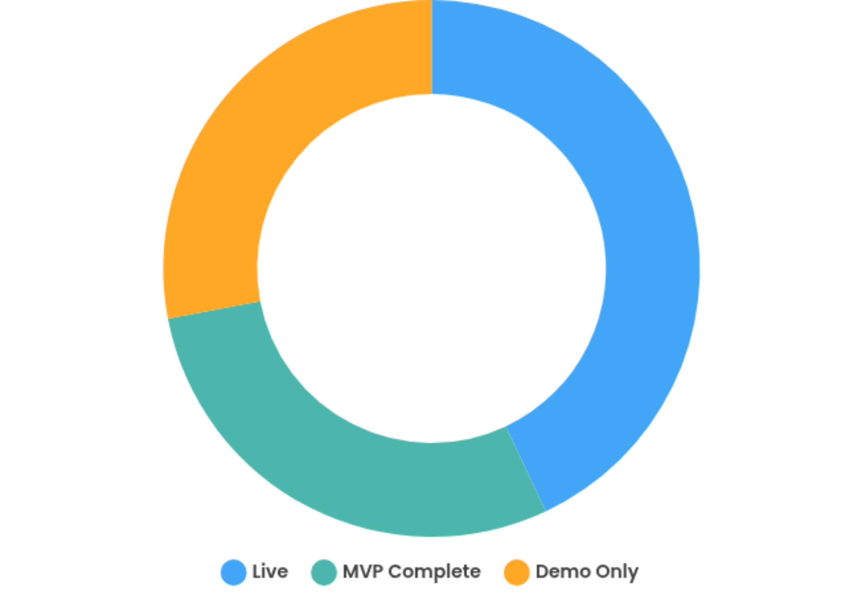

DELIVERY STATUS
Distribution
Overview of solution maturity across the AI portfolio, showcasing the balance between production-ready systems, MVPs in development, and concept demonstrations.
7
Live & Production
Healthcare AI • DiagnosticCentre • Conversational AI
Solutions
MVP Complete
AR/VR Medical Learning
Demo Only
Pharmacist Chatbot • Banking OCR Platform
AI INNOVATIONS

Slide 18
Common Patterns
Multimodal Interfaces
Human-in-the-Loop
Text, voice, images, scanned documents
Expert validation for safety & compliance
CROSS-PROJECT ANALYSIS
Multilingual Support
Modular Microservices
Comparative Insights
Bangla, English, Banglish, 40+ languages
RESTful APIs & reusable components
Identifying common patterns and synergies across the AI portfolio enables strategic reuse and accelerates time-to-value for new initiatives.
Data Governance
Cross-Vertical Reuse
End-to-end MLOps pipelines
Shared OCR & biometrics modules
Key Synergies
OCR Engine Reuse: Healthcare prescription engine repurposed for bank forms
Voice Biometrics: Banking authentication securing patient portals & e-pharmacy
Doctor + Pharmacist: AI doctor calls pharmacist module for prescription analysis
Unified Data Layer: Structured data feeds analytics across verticals
AI INNOVATIONS

Slide 19
PLATFORM MATURITY
Current Status
FUTURE SCOPE
Complete Financial Platform
Blockchain Enablement
Blockchain-Backed Wallet
Identity & Access
Wallet Management
Tokenized balance representation & on-chain recording
✓ Live
✓ Live
Stablecoin-Based Payments
Remittance, cross-border settlement, merchant payments
Payments & Transactions
Ledger & Accounting
Smart Contract Automation
✓ Live
✓ Live
Programmable treasury workflows & payment automation
Hybrid Fiat-Crypto Wallet
KYC/KYB Onboarding
Compliance & Sanctions
Seamless fiat-to-crypto and crypto-to-fiat transactions
✓ Live
✓ Live
Blockchain Identity Verification
Decentralized credentials & external network integrations
Support & Operations
Cloud Deployment
✓ Live
✓ Live
AI INNOVATIONS

Slide 20
STRATEGIC CONCLUSION
Strategic Value
Portfolio Strengths
Our AI-powered solutions demonstrate proven business impact across healthcare and financial sectors with quantifiable outcomes and scalable architecture.
Configurable Platform Core
Blockchain-Enabled Future
MFS, digital banking, payment gateway, merchant payouts
Hybrid Web2-Web3 wallet with crypto settlement
Modular architectures designed for cross-vertical expansion
Next Steps
Human oversight ensuring trust and regulatory compliance
1
Client-specific customization & branding
2
Continued R&D on blockchain integration
Quantifiable business impact with measurable ROI
3
Expanded multilingual support beyond Bangla & English
4
Wearables & IoT device integration
Future-ready platform for AI-first transformation
5
Agentic AI for proactive recommendations
AI INNOVATIONS

